Slide 1



The Analytical Engine
John Stovin | FSharp Exchange 2019
@johnstovin

Slide 2


Notes:
Around 2010, I stumbled upon Sydney Padua’s 2D Goggles website.
First few episodes of ‘The Thrilling Adventures’, published in 2015.
Pocket universe where L & B use the Analytical Engine to fight crime,
Comics! With Footnotes!
Also a wealth of information on the workings of the Engine
Went to see her talk at Sheffield Library.
Looking for inspiration for an F# project, I thought of an Analytical Engine Simulator

Slide 3
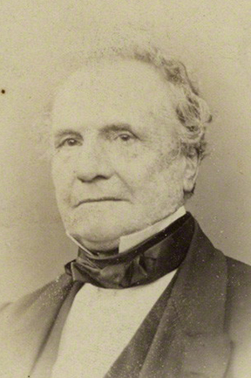
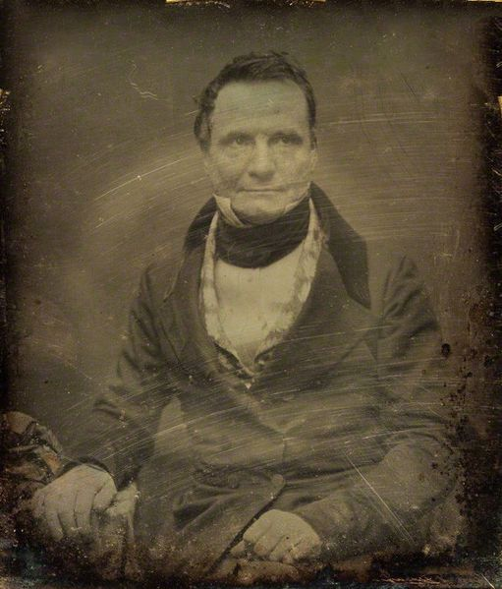
Notes:
The real Charles Babbage (1791 – 1871)
A true polymath
Mathematician, philosopher, inventor and mechanical engineer

Slide 4
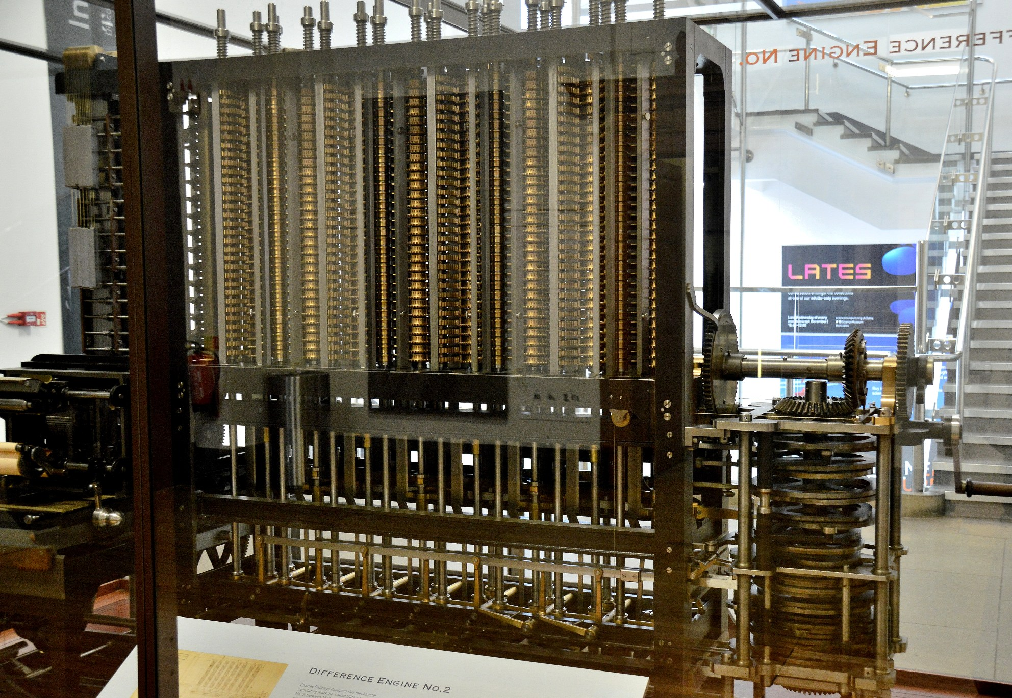
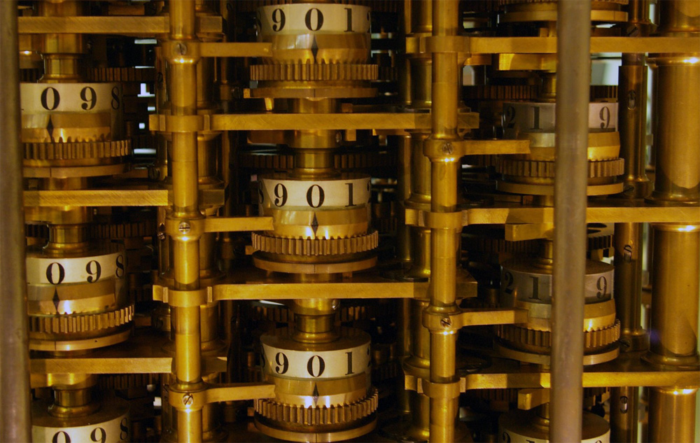
Notes:
Difference Engine– proof of concept -1819-22
Govt. grant of £1,700 to develop D.E. No. 1 in 1823 (20 digits, 6th order differences)
Designed to calculate & print mathematical tables to eradicate human error
1832 - small working model of part of the mechanism – 6 digits, 2nd order differences
Govt abandoned in1842 after spending £17,000
1846-49 – design for engine No. 2 (31 digits, 7th order differences) fewer parts and faster operation thanks to Analytical Engine

Slide 5
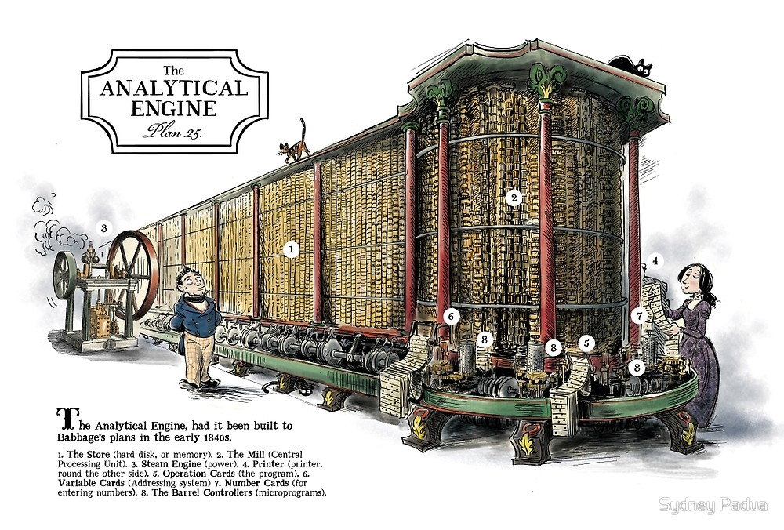
Notes:
Started design in 1833
Punched cards for input
Store – 1,000 x 40 (or 50?) digit numbers
Mill – ALU – Add, Subtract, Multiply, Divide, comparison, optional square root
‘Microcode’ architecture – single punched card could trigger a sequence of actions

Slide 6
Architecture
40- (50-?) digit decimal “word”
1000 word Store
Control flow by punched cards
10s complement for negative values
Notes:
Why decimal? So that values could be printed – transcription errors were a big problem
Cards – 4 different readers – synchronisation mechanism not clear
John Walker simplified into a single instruction sequence

Slide 7
The Mill
Mill performs basic maths operations (+, -, *, /)
2 ingress axes, 1 egress axis
Load operations load ingress axes alternately
2nd load automatically triggers mill operation
Run up lever set if an operation causes an overflow
Notes:
Also optional square root unit
This is simplified from Babbage’s designs – I have ignore the primed axes on ingress and egress for example.

Slide 8
Instruction Set
Number Cards
Naaa [+-]nnn… :Store value nnn... at aaa
Operation Cards
+, -, *, /
Variable Cards
Laaa : Load value at aaa into ingress axes
Zaaa : Load value at aaa and set value to zero
Saaa : Save egress axis to address aaa
Notes:
John Walker – founder of AutoDesk – has gathered together a lot of Analytical Engine-related material at fourmilab.ch
He devised the instruction set I’m using

Slide 9
Instruction Set 2
Combinatorial Cards
C[FB][+?]nn
F: forward, B: back, +: always, ?:if run up lever is set
nn: number of instructions to skip
Action Cards
B: Ring bell
H: Halt
P: Print the value on the axis
No character in column1: Comment
Notes:
John Walker – founder of AutoDesk – has gathered together a lot of Analytical Engine-related material at fourmilab.ch
He devised the instruction set I’m using
What program should we write to test this out? It’s an FP conference so…

Slide 10
Fibonacci Sequence
N004 30 . No of terms
N000 0 . Constant zero
N005 1 . Constant 1
N001 0 . Previous term
N002 1 . Current term
N003 . Next term
+
L002
P
L001 . curr + prev
S003 . -> next
L002
L000
S001 . curr -> prev
L003
L000
S002 . next -> curr
-
L004
L005
S004 . dec iteration
CF?1 . stop on run up
CB+17 . repeat
H
Notes:
This is a functional programming conference…
2 columns to make it legible

Slide 11
Type Definitions
type Wheel =
| Pos0 | Pos1 | Pos2 | Pos3
| Pos4 | Pos5 | Pos6 | Pos7
| Pos8 | Pos9
type Stack = {
wheels: Wheel list
negative : bool }
Notes:
To make this interesting, were not going to use built-in integer maths

Slide 12
Wheel
module Wheel
open Types
let values = [Pos0;Pos1;Pos2;Pos3;Pos4;Pos5;Pos6;Pos7;Pos8;Pos9]
let indexOf wheel =
values |> List.findIndex (fun v -> v = wheel)
let valueAt index =
values.[index % values.Length]
let inc wheel = valueAt (indexOf wheel + 1)
let dec wheel = valueAt (indexOf wheel - 1)

Slide 13
(Half) Addition
let add wheel1 wheel2 =
let mutable carry = false
let mutable result = wheel1
let mutable addor = wheel2
while addor <> Pos0 do
addor <- dec addor
result <- inc result
carry <- carry || result = Pos0
(result, carry)
Notes:
A binary half-adder takes 2 binary values and provides a result and a carry value – similar for decimal
In the Analytical Engine, only stacks in the mill would have had the ability to carry from one wheel to the next.

Slide 14
Negative Values
let complements = values |> List.rev
let withComplements = List.zip values complements
let complement wheel =
withComplements
|> List.find (fun w -> fst w = wheel) |> snd
Notes:
2s complement – invert (subtract from 1) each digit then add 1
10s complement – subtract each digit from 9 then add 1
Can also find complement by reading the integer sequence in reverse

Slide 15
Negate the Stack
let carryUp (carry : bool) (wheel: Wheel) =
((if carry then wheel |> Wheel.inc else wheel),
(wheel = Pos9 && carry))
let add1 wheels =
wheels |> List.mapFold carryUp true |> fst
let complement wheels =
wheels |> List.map Wheel.complement |> add1
let negate stack =
{ wheels = stack.wheels |> complement
negative = not stack.negative }
Notes:
Mapfold takes a mapping function, an initial state and a list, applies the fn to each element an returns a tuple of result list and final state

Slide 16
Full Adder
let add (ingress : Stack list) =
let carryUp carryIn (wheel, carryThrough) =
let wheel' = if carryIn then Wheel.inc wheel else wheel
let carryOut = (wheel = Pos9 && carryIn) || carryThrough
(wheel', carryOut)
let wheels, carry =
List.zip ingress.[0].wheels ingress.[1].wheels
|> List.map (fun (w1, w2) -> Wheel.add w1 w2)
|> List.mapFold carryUp false
let negative =
ingress.[0].negative <> ingress.[1].negative <> carry
let runUp = ingress.[0].negative <> negative
({ wheels = wheels; negative = negative }, runUp )
Notes:
This is in the Mill module, so has access to the 2 ingress axes
<> is used as an XOR here

Slide 17
Still To Do
Primed ingress and egress axes
Multiplication
Division
Square Roots?
Control Console
Run at realistic speeds
Notes:
Primed axes store overflow or modulus values
Multiplication and division requires shift up and down operations, and repeated addition/subtraction
Square roots by Newton-Raphson approximation
Console to allow single stepping and inspection of all values, maybe tracing
Babbage estimated that the engine should be capable of performing a single 40-digit add operation in 19 seconds.
Clever ‘scheduling’ would allow subsequent adds to take around 3 seconds
Multiplying 20 digits by 40 digits would take around 2 minutes – simple step and add would be nearer 8 minutes

Slide 18
‘Missing’ Features
Simpler program structure
(single card sequence)
More branching options
Indexed addressing
Notes:
If the Engine had been used in anger, users would probably soon ask for more features, including
Now you know how to build an Analytical Engine, so it’s time to…

Slide 19

Go out & FIGHT CRIME!

Slide 20
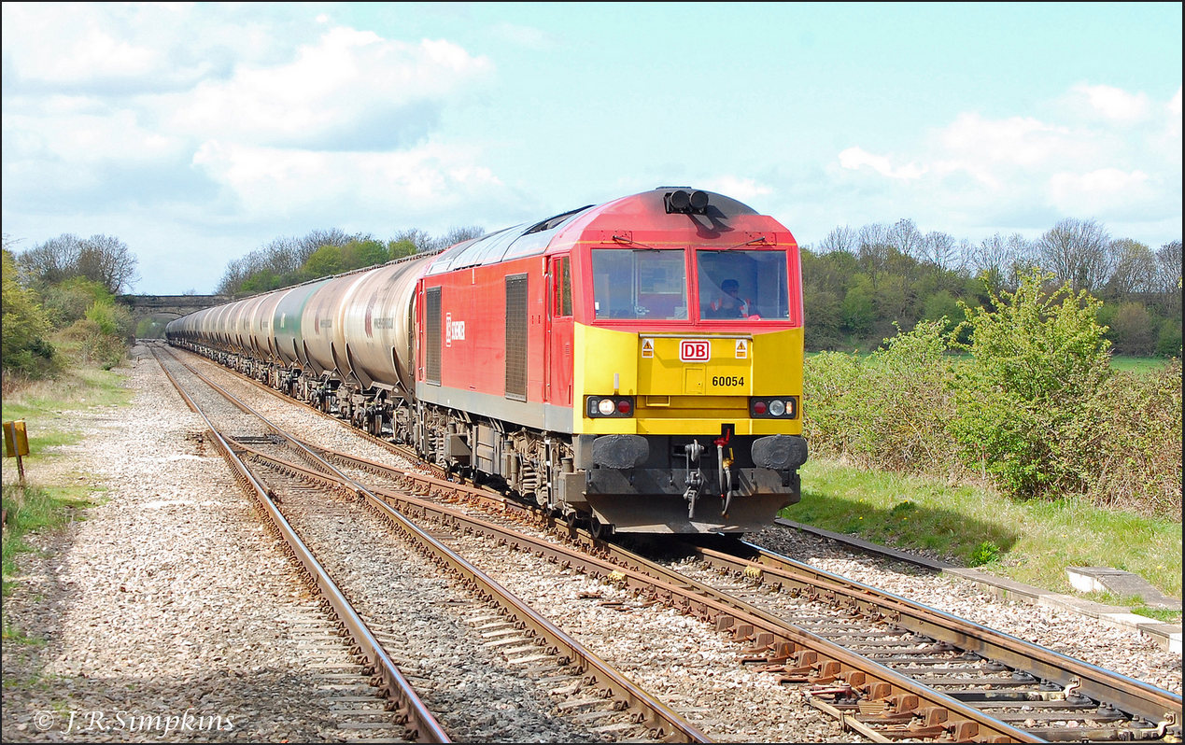
Credits & References
Many thanks to Sydney Padua for the use of her amazing illustrations
2DGoggles: http://sydneypadua.com/2dgoggles/
The Thrilling Adventures of Lovelace & Babbage (Particular Books, 2015)
Fourmilab: http://www.fourmilab.ch/babbage/
Code and slides: https://github.com/JohnStov/AnalyticalEngine
Notes:
Lots of other Babbage & Analytical Engine resources around the web
Sydney Padua has become a minor Babbage scholar in her own right
There is a class 60 locomotive (No 54) named ‘Charles Babbage’
Babbage briefly worked for the Liverpool & Manchester Railway Company, and invented the locomotive ‘pilot’ designed to prevent stray items on the track from interfering with the locomotive.

